Slide 1
Public Health

Slide 2
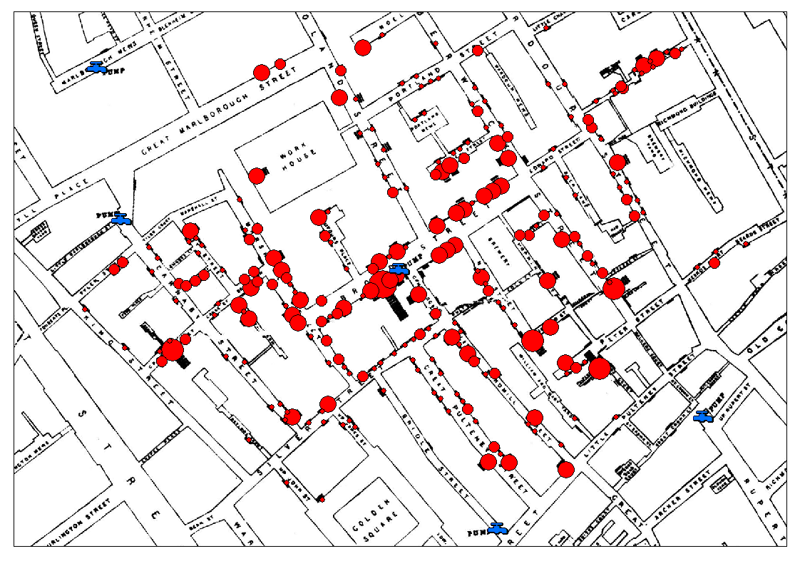

Slide 3
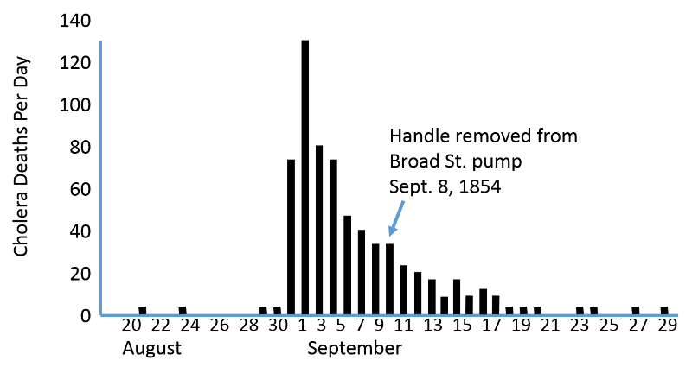
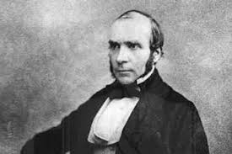
Cholera… - Dr. John Snow had the “crazy idea” that cholera had something to do with water contaminated by sewage
- Idea was dismissed wildly, miasma or contaminated air was blamed
https://www.ph.ucla.edu/epi/snow/snowcricketarticle.html

Slide 4
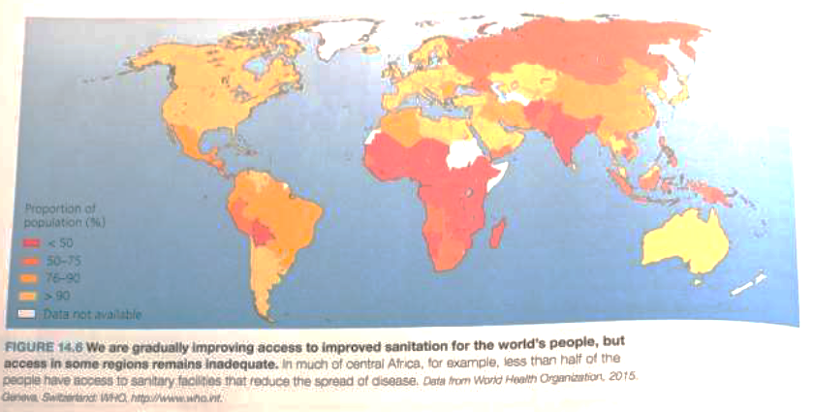

Slide 5
Toxicity

Slide 6
In genetics, a mutagen is a physical or chemical agent that changes the genetic material, usually DNA, of an organism and thus increases the frequency of mutations above the natural background level.
A teratogen is an agent that can disturb the development of the embryo or fetus. Teratogens halt the pregnancy or produce a congenital malformation (a birth defect). Classes of teratogens include radiation, maternal infections, chemicals, and drugs.

Slide 7
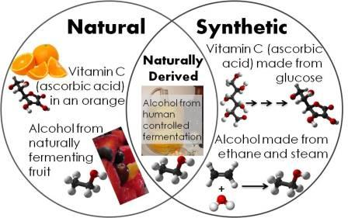
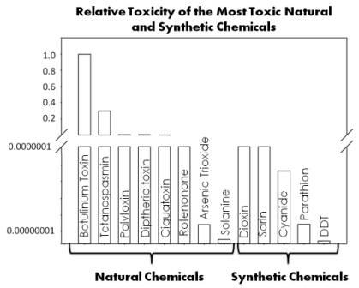
Synthetic vs. natural chemicals
Misconception: Synthetic chemicals are more toxic than natural chemicals.
The two most toxic chemicals for humans, that we know of, are botulinum toxin and tetanospasmin. Botulism is caused by botulinum toxin, which is a protein and neurotoxin produced by bacteria spores. Tetanospasmin is a neurotoxin produced by bacteria that causes Tetanus. I created a bar graph to help us visualize the relative toxicities of the most toxic natural and synthetic chemicals to humans:

Slide 8
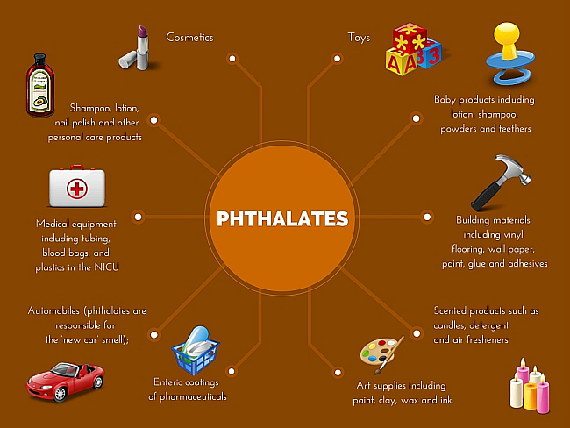
Phthalates are a group of chemicals found in many of these plastic products. They are additives known as plasticizers which are plastic additives that add flexibility and other desirable characteristics to industrial and consumer products. They also help plastic products retain their colors and scents.

Slide 9
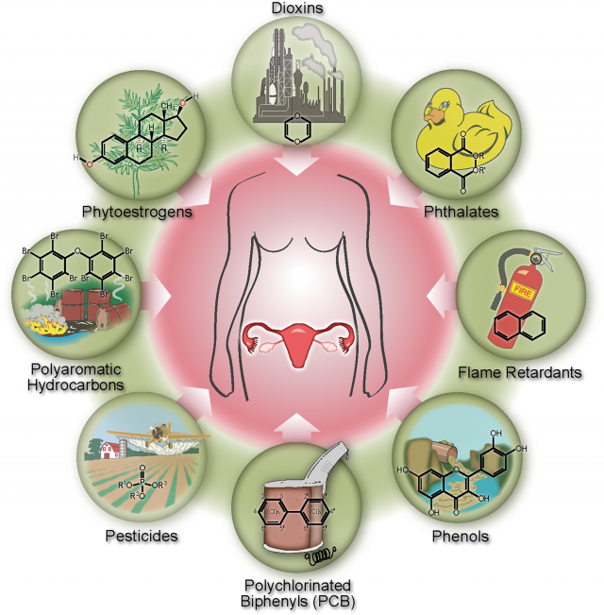
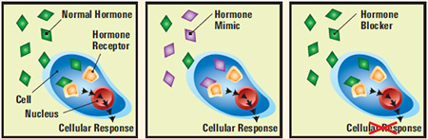
Endocrine disruptors are chemicals that can interfere with endocrine (or hormone) systems at certain doses. These disruptions can cause cancerous tumors, birth defects, and other developmental disorders. Any system in the body controlled by hormones can be derailed by hormone disruptors.

Slide 10
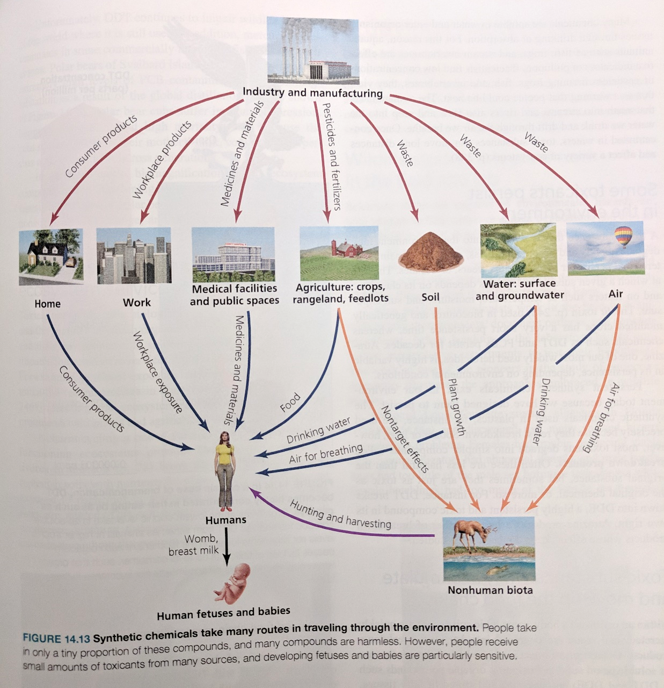

Slide 11
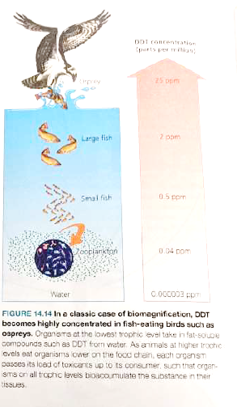
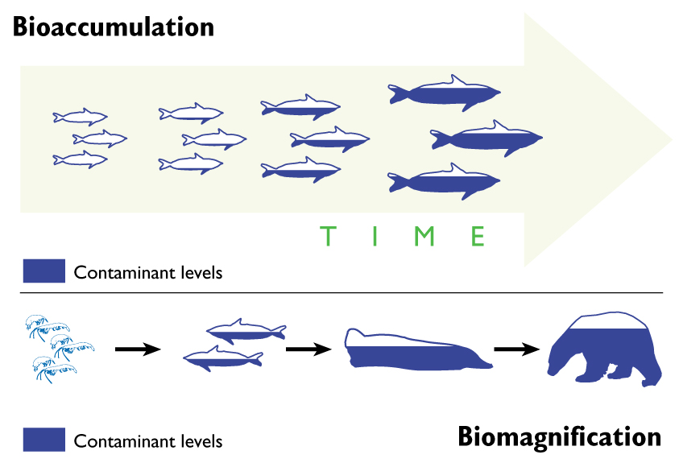
Bioaccumulation is the accumulation of substances, such as pesticides, or other chemicals in an organism. Bioaccumulation occurs when an organism absorbs a substance at a rate faster than that at which the substance is lost by catabolism and excretion.

Slide 12


